Slide 1
UNIT 3 WT
By Dr Prasanna B T

Slide 2
JAVA Script: Client Side Scripting

Slide 3
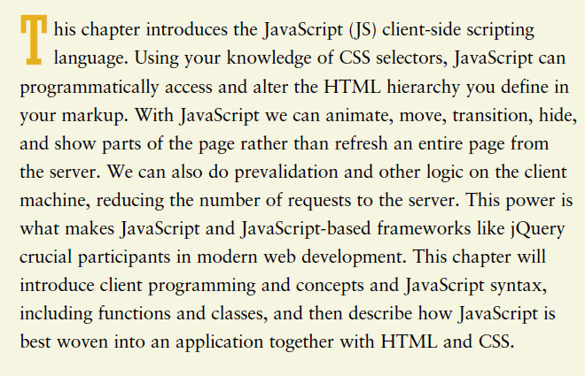

Slide 4
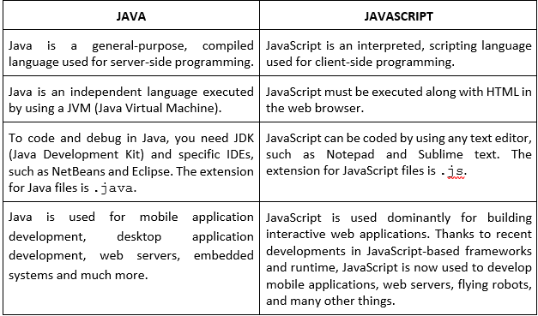

Slide 5
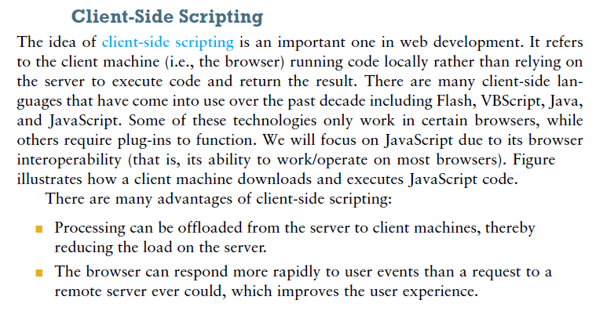
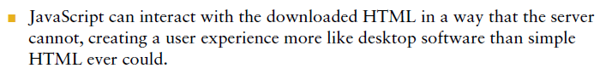

Slide 6
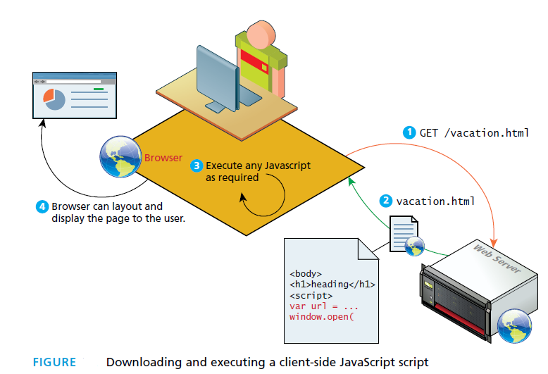

Slide 7
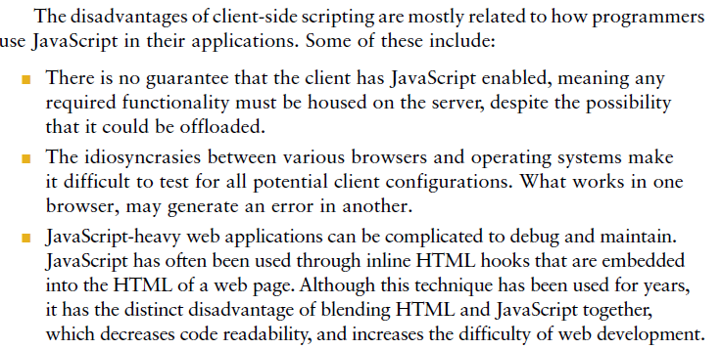

Slide 8
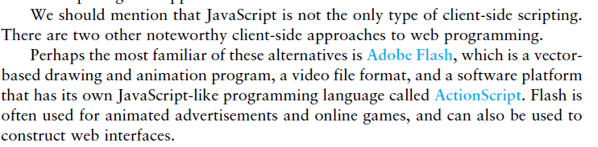
Vector based Animation Tools:
OpenToonz
Synfig Studio
Adobe Animate
Krita
Moho Pro

Slide 9
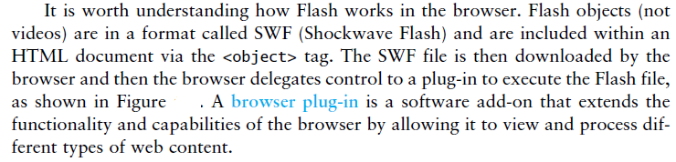

Slide 10
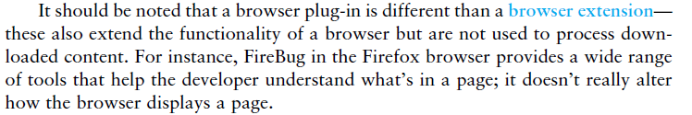

Slide 11
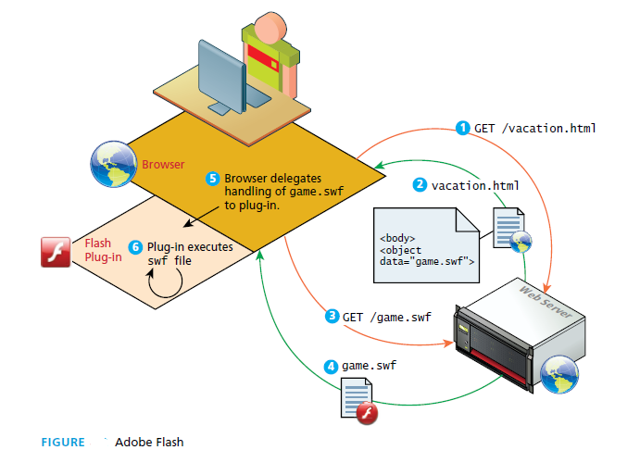

Slide 12
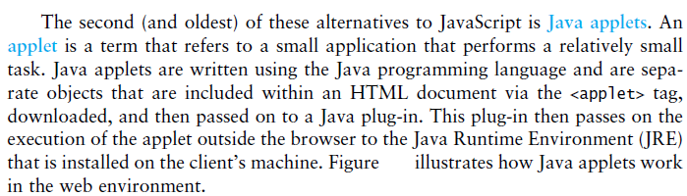

Slide 13
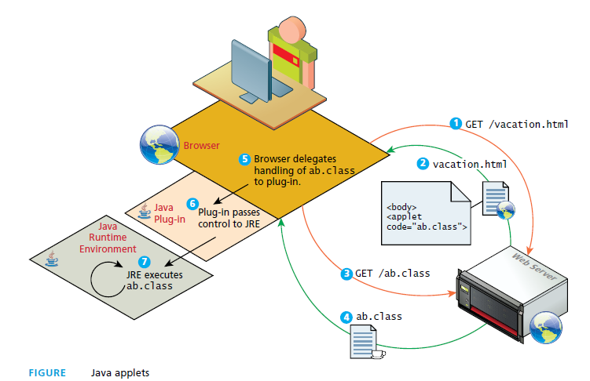

Slide 14
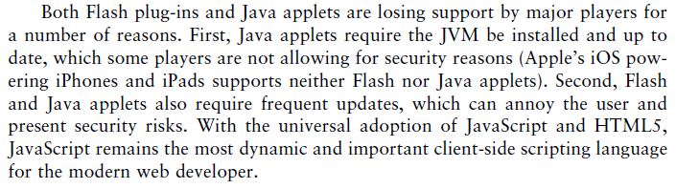

Slide 15
What is AJAX?
AJAX = Asynchronous JavaScript And XML.
AJAX is not a programming language.
AJAX just uses a combination of:
A browser built-in XMLHttpRequest object (to request data from a web server)
JavaScript and HTML DOM (to display or use the data)

Slide 16
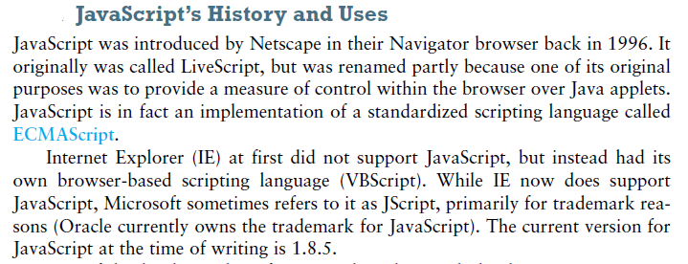
https://www.youtube.com/watch?v=4MsfBokJiSs&list=PLsyeobzWxl7rrvgG7MLNIMSTzVCDZZcT4&index=9

Slide 17
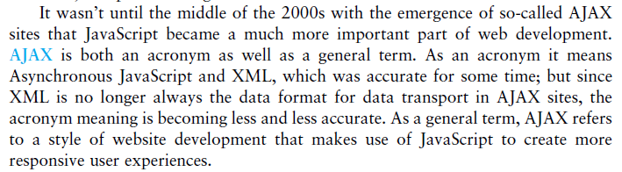

Slide 18
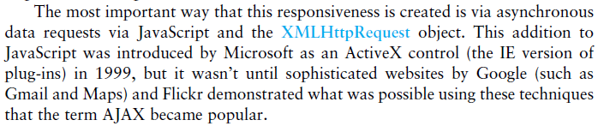

Slide 19
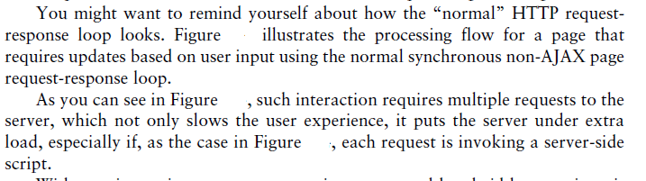

Slide 20
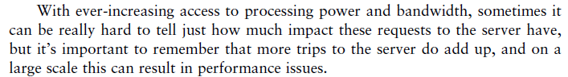

Slide 21
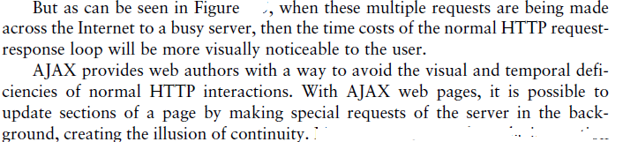

Slide 22
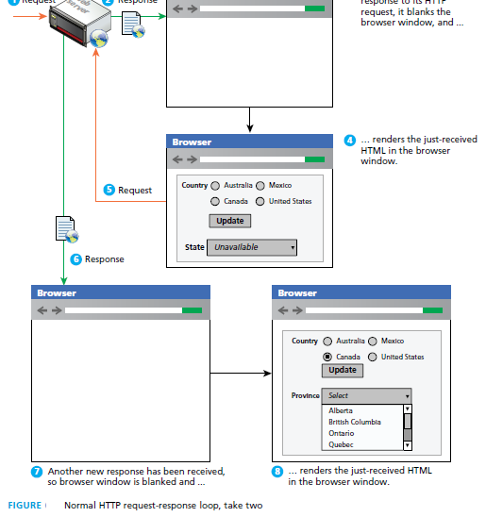

Slide 23
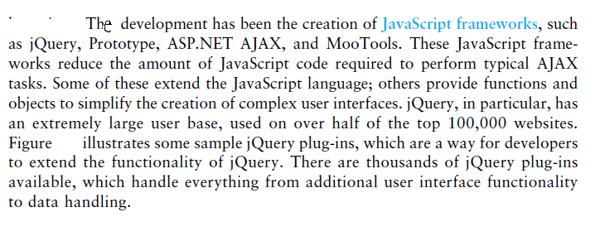

Slide 24
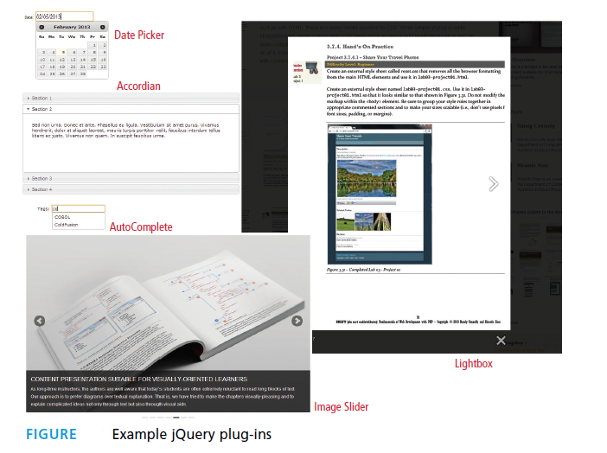

Slide 25
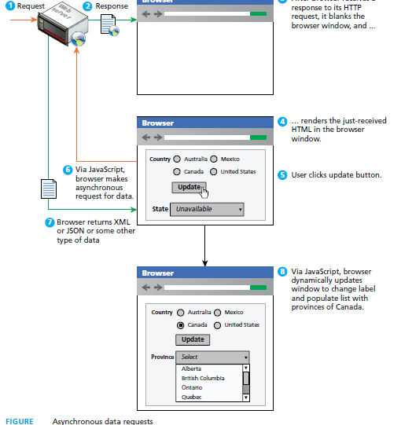
Figure illustrates how the interaction shown in Figure normal flow would differ in an AJAX-enhanced web page

Slide 26
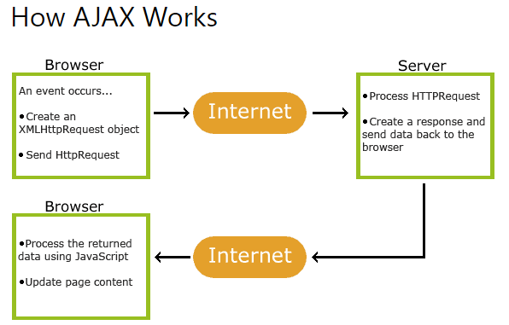

Slide 27
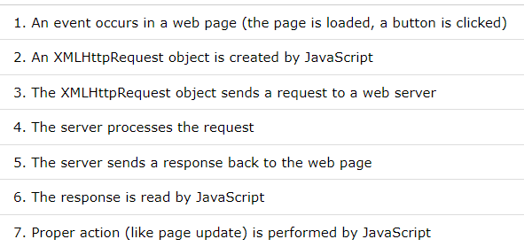

Slide 28
<!DOCTYPE html>
<html>
<body>
<div id="demo">
<h1>The XMLHttpRequest Object</h1>
<button type="button" onclick="loadDoc()">Change Content</button>
</div>
<script>
function loadDoc() {
var xhttp = new XMLHttpRequest();
xhttp.onreadystatechange = function() {
if (this.readyState == 4 && this.status == 200) {
document.getElementById("demo").innerHTML =
this.responseText;
}
};
xhttp.open("GET", "ajax_info.txt", true);
xhttp.send();
}
</script>
</body>
</html>

Slide 29
The "ajax_info.txt" file used in the example above, is a simple text file and looks like this:
<h1>AJAX</h1> <p>AJAX is not a programming language.</p> <p>AJAX is a technique for accessing web servers from a web page.</p> <p>AJAX stands for Asynchronous JavaScript And XML.</p>

Slide 30
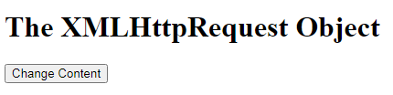
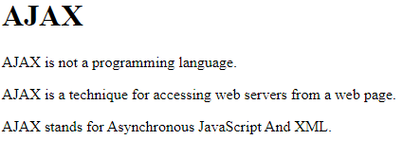
On click of Button O/p will be

Slide 31
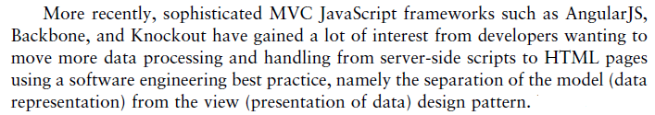


Slide 32
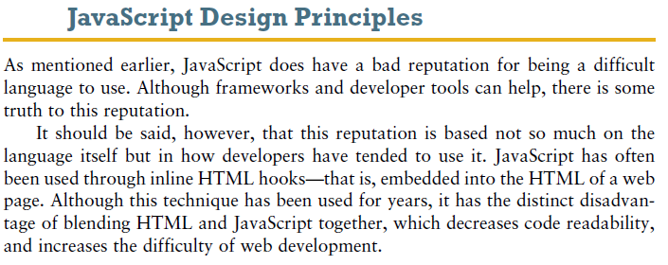

Slide 33
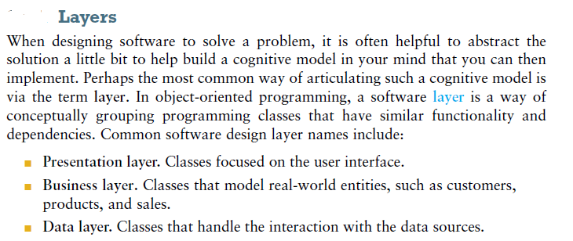

Slide 34
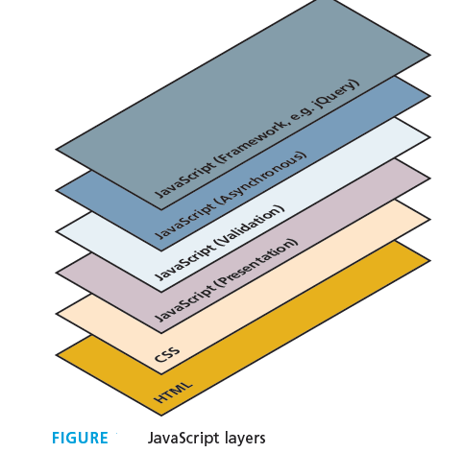

Slide 35
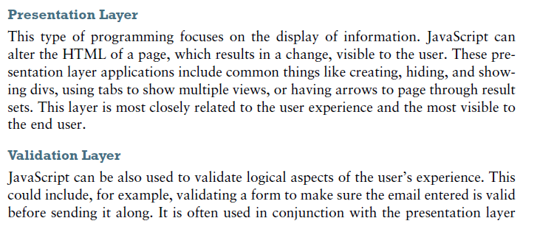
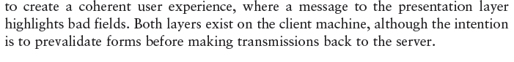

Slide 36
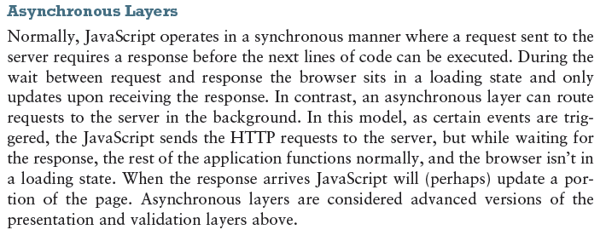

Slide 37
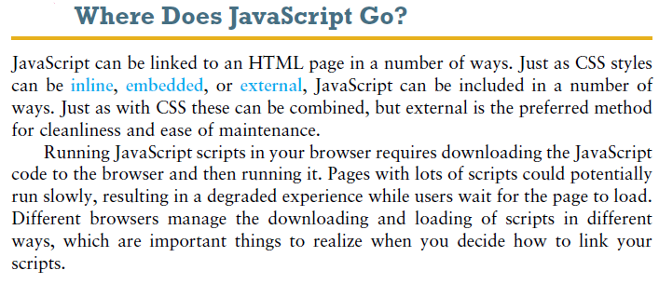

Slide 38
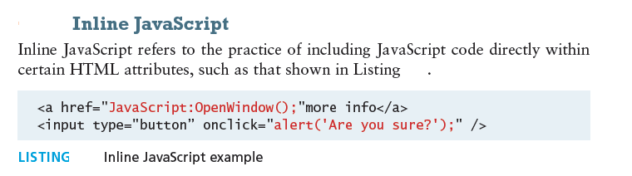

Slide 39
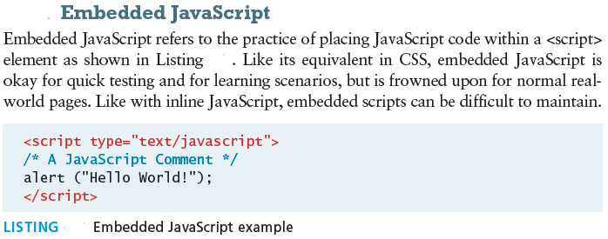

Slide 40
<!DOCTYPE html >
<html>
<head>
<h2> This is a simple HTML file</h2> <script>
document.write("Hi, This is an inline Javascript code written in between script tags");
</script>
</head>
</html>

Slide 41
Explanation
Step 1 −In a simple html file, add a heading tag <h2> and display the heading of your choosing.
Step 2 −Add a script tag <script> below the heading tag.
Step 3 −In the script tag, print a text using document.write() function.

Slide 42
<!DOCTYPE html >
<html>
<head>
<h2> This is a simple HTML file</h2>
<script>
document.write("An Inline Javascript code to display an array")
document.write("<br>")
const inputArray = [3,4,5,6,7,8]
document.write("The array is defined as :“, inputArray)
</script>
</head>
</html>

Slide 43
Explanation
Step 1 −In a simple html file, add a heading tag <h2> and display the heading of your choosing.
Step 2 −Add a script tag <script> below the heading tag.
Step 3 −In the script tag, define an array namely inputArray and add numeric values to the array.
Step 4 −Print the array using document.write() function.

Slide 44
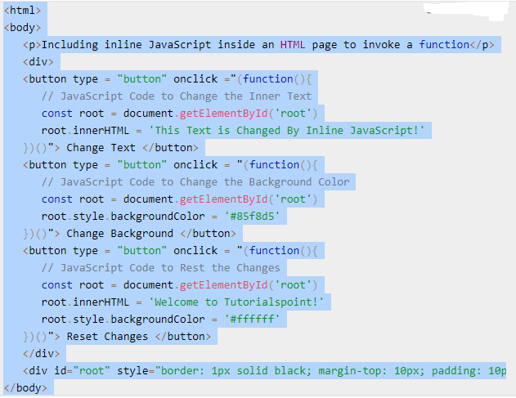

Slide 45
https://www.tutorialspoint.com/How-to-include-inline-JavaScript-inside-an-HTML-page

Slide 46
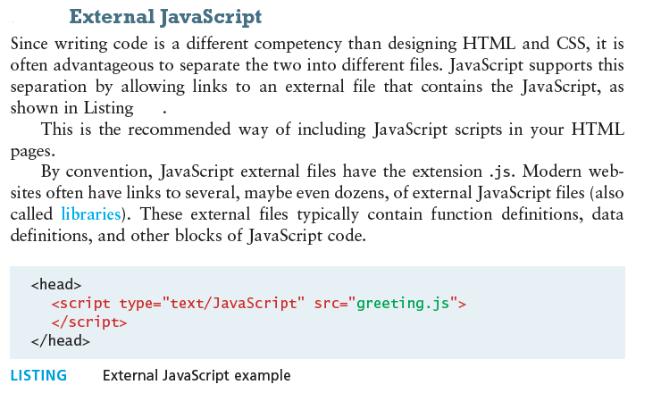

Slide 47
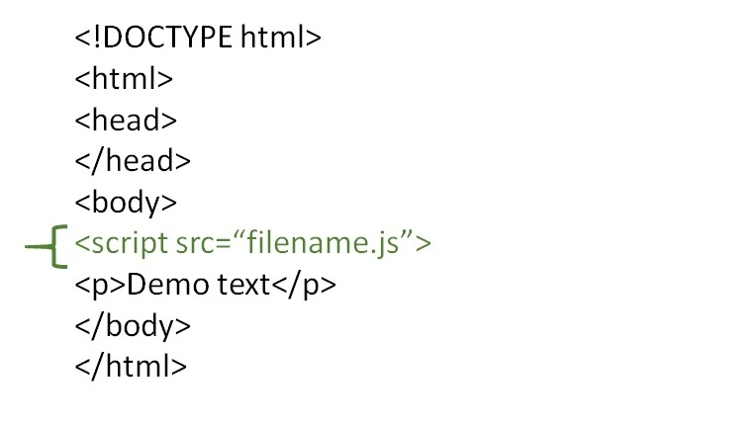

Slide 48
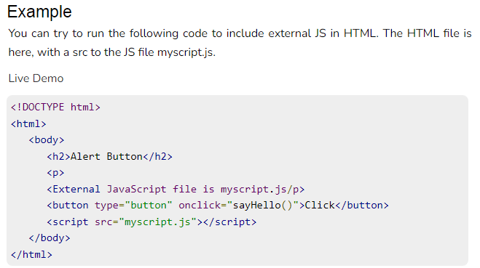

Slide 49
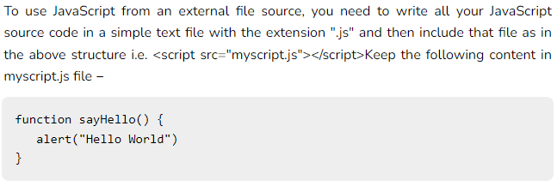

Slide 50
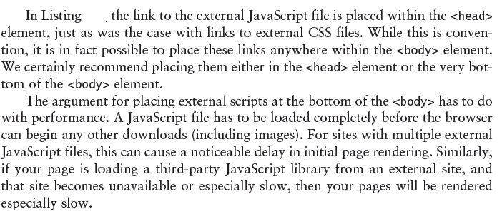

Slide 51
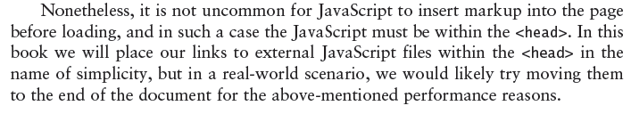

Slide 52
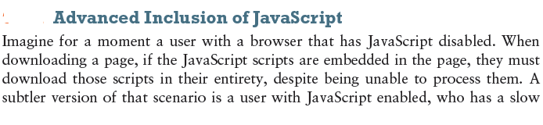
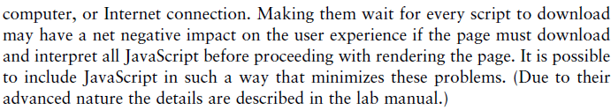

Slide 53
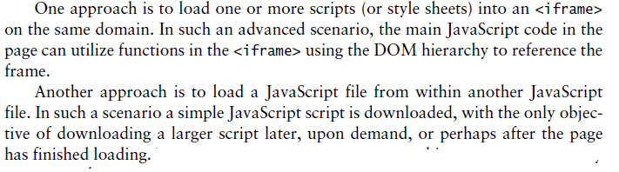

Slide 54
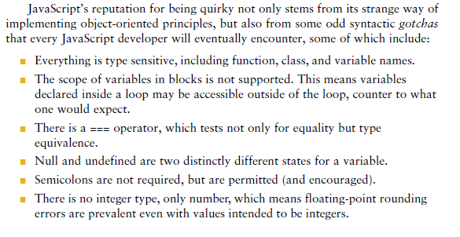
Synatx:

Slide 55
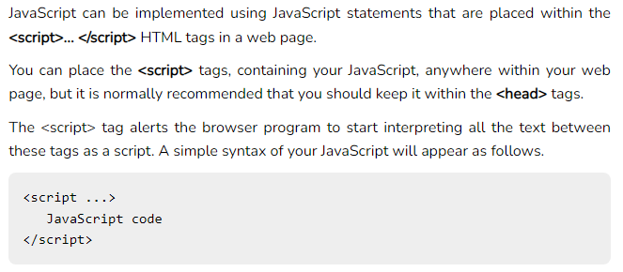

Slide 56
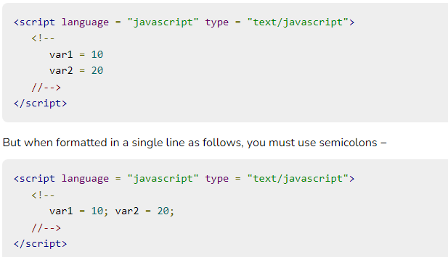
Whitespace and Line Breaks
JavaScript ignores spaces, tabs, and newlines that appear in JavaScript programs
Semicolons are Optional

Slide 57
Case Sensitivity
JavaScript is a case-sensitive language. This means that the language keywords, variables, function names, and any other identifiers must always be typed with a consistent capitalization of letters.

Slide 58


Slide 59


Slide 60


Slide 61


Slide 62


Slide 63


Slide 64


Slide 65


Slide 66



Slide 67

Java Script in external file

Slide 68


Slide 69


Slide 70
Note − JavaScript does not make a distinction between integer values and floating-point values. All numbers in JavaScript are represented as floating-point values. JavaScript represents numbers using the 64-bit floating-point format defined by the IEEE 754 standard.

Slide 71


Javascript Variables

Slide 72


Slide 73


Slide 74


Slide 75
JavaScript Reserved Words
A list of all the reserved words in JavaScript are given in the following table. They cannot be used as JavaScript variables, functions, methods, loop labels, or any object names.

Slide 76


Slide 77


Slide 78


Slide 79

Arithmetic Operators

Slide 80


Slide 81


Slide 82


Slide 83

Comparison Operators

Slide 84


Logical Operators

Slide 85


Slide 86


Slide 87


Slide 88


Slide 89



Slide 90



Slide 91


Slide 92


Slide 93


Slide 94

Loops

Slide 95


Slide 96


Slide 97


Slide 98


Slide 99


Slide 100

Calling a function

Slide 101

Function Parameters

Slide 102


Slide 103


Slide 104


Slide 105
DOM
Document Object Model (DOM) objects that correspond to the content of a
page’s HTML. These DOM objects let JavaScript code access and modify HTML
and CSS properties of a page dynamically.

Slide 106
W3C Definition of DOM
Platform- and language-neutral interface that will allow programs and scripts to dynamically access and update the content, structure and style of documents
In the DOM, each element within the HTML document is called a node. If the
DOM is a tree, then each node is an individual branch. There are element nodes,
text nodes, and attribute nodes

Slide 107


Slide 108


Slide 109


Slide 110


Slide 111


Slide 112
Object
In JavaScript, almost "everything" is an object.
Booleans can be objects (if defined with the new keyword)
Numbers can be objects (if defined with the new keyword)
Strings can be objects (if defined with the new keyword)
Dates are always objects
Maths are always objects
Regular expressions are always objects
Arrays are always objects
Functions are always objects
Objects are always objects
All JavaScript values, except primitives, are objects.

Slide 113
Object Methods
Methods are actions that can be performed on objects.
Object properties can be both primitive values, other objects, and functions.
An object method is an object property containing a function definition.

Slide 114

Java Script Object Methods
<!DOCTYPE html>
<html>
<body>
<h1>The JavaScript <i>this</i> Keyword</h1>
<p>In this example, <b>this</b> refers to the <b>person</b> object.</p>
<p>Because <b>fullName</b> is a method of the person object.</p>
<p id="demo"></p>
<script>
// Create an object:
const person = {
firstName: "John",
lastName: "Doe",
id: 5566,
fullName : function() {
return this.firstName + " " + this.lastName;
}
};
// Display data from the object:
document.getElementById("demo").innerHTML = person.fullName();
</script>
</body>
</html>

Slide 115
Using Object literal
const person = { firstName: "John", lastName: "Doe", age: 50, eyeColor: "blue" };

Slide 116
Using the JavaScript Keyword new
const person = new Object(); person.firstName = "John"; person.lastName = "Doe"; person.age = 50; person.eyeColor = "blue";

Slide 117
JavaScript Arrays
const cars = ["Saab", "Volvo", "BMW"];
const array_name = [item1, item2, ...];
const cars = [ "Saab", "Volvo", "BMW" ];

Slide 118
const cars = []; cars[0]= "Saab"; cars[1]= "Volvo"; cars[2]= "BMW";
Using Javascript new
const cars = new Array("Saab", "Volvo", "BMW");

Slide 119
Accessing array elements
const cars = ["Saab", "Volvo", "BMW"]; let car = cars[0];
Array to string:
const fruits = ["Banana", "Orange", "Apple", "Mango"]; document.getElementById("demo").innerHTML = fruits.toString();

Slide 120
const person = {firstName:"John", lastName:"Doe", age:46};
Array Elements Can Be Objects
myArray[0] = Date.now; myArray[1] = myFunction; myArray[2] = myCars;
Array Properties and Methods
cars.length // Returns the number of elements cars.sort() // Sorts the array

Slide 121
The length property of an array returns the length of an array (the number of array elements).
const fruits = ["Banana", "Orange", "Apple", "Mango"]; let length = fruits.length;

Slide 122
Accessing last array element
const fruits = ["Banana", "Orange", "Apple", "Mango"]; let fruit = fruits[fruits.length - 1];

Slide 123



Slide 124



Slide 125
Adding Array Elements
The easiest way to add a new element to an array is using the push() method:
const fruits = ["Banana", "Orange", "Apple"]; fruits.push("Lemon"); // Adds a new element (Lemon) to fruits

Slide 126



Slide 127
New element can also be added to an array using the length property:
const fruits = ["Banana", "Orange", "Apple"]; fruits[fruits.length] = "Lemon"; // Adds "Lemon" to fruits

Slide 128
The Difference Between Arrays and Objects
In JavaScript, arrays use numbered indexes.
In JavaScript, objects use named indexes.
When to Use Arrays. When to use Objects.
JavaScript does not support associative arrays.
You should use objects when you want the element names to be strings (text).
You should use arrays when you want the element names to be numbers.

Slide 129
JavaScript new Array()
JavaScript has a built-in array constructor new Array().
But you can safely use [] instead.
These two different statements both create a new empty array named points:
const points = new Array(); const points = [];
const points = new Array(40, 100, 1, 5, 25, 10); const points = [40, 100, 1, 5, 25, 10];

Slide 130
The pop method can be used to remove an item from the back of an array.
Additional methods that modify arrays include concat(), slice(), join(), reverse(), shift(), and sort().

Slide 131


The JavaScript Math object allows you to perform mathematical tasks on numbers.

Slide 132
The Math Object
Unlike other objects, the Math object has no constructor.
The Math object is static.
All methods and properties can be used without creating a Math object first.

Slide 133
Math Properties (Constants)
The syntax for any Math property is : Math.property.
JavaScript provides 8 mathematical constants that can be accessed as Math properties:

Slide 134


Slide 135
Math Methods
The syntax for Math any methods is : Math.method(number)
Number to Integer
There are 4 common methods to round a number to an integer:

Slide 136


Slide 137

JavaScript Math Methods

Slide 138


Slide 139


Slide 140


Slide 141


Slide 142


Slide 143
Javascript Events
At the core of all JavaScript programming is the concept of an event.
A JavaScript event is an action that can be detected by JavaScript. Many of them are initiated by user actions but some are generated by the browser itself.
We say then that an event is triggered and then it can be caught by JavaScript functions, which then do something in response

Slide 144
JavaScript HTML DOM Events
HTML DOM allows JavaScript to react to HTML events:
Reacting to Events
A JavaScript can be executed when an event occurs, like when a user clicks on an HTML element.
To execute code when a user clicks on an element, add JavaScript code to an HTML event attribute:
onclick=JavaScript

Slide 145
Examples of HTML events:
When a user clicks the mouse
When a web page has loaded
When an image has been loaded
When the mouse moves over an element
When an input field is changed
When an HTML form is submitted
When a user strokes a key

Slide 146


In this example, the content of the <h2> element is changed when a user clicks on it:
<!DOCTYPE html>
<html>
<body>
<h2>JavaScript HTML Events</h2>
<h2 onclick="this.innerHTML='Ooops!'">Click on this text!</h2>
</body>
</html>

Slide 147
<!DOCTYPE html>
<html>
<body>
<h2>JavaScript HTML Events</h2>
<h2 onclick="changeText(this)">Click on this text!</h2>
<script>
function changeText(id) {
id.innerHTML = "Ooops!";
}
</script>
</body>
</html>

Slide 148



Slide 149



Slide 150
The onload and onunload Events
The onload and onunload events are triggered when the user enters or leaves the page.
The onload event can be used to check the visitor's browser type and browser version, and load the proper version of the web page based on the information.
The onload and onunload events can be used to deal with cookies.

Slide 151



Slide 152
The onchange Event
The onchange event is often used in combination with validation of input fields.
Below is an example of how to use the onchange. The upperCase() function will be called when a user changes the content of an input field.

Slide 153




Slide 154
The onmouseover and onmouseout Events
The onmouseover and onmouseout events can be used to trigger a function when the user mouses over, or out of, an HTML element:

Slide 155
The onmousedown, onmouseup and onclick Events
The onmousedown, onmouseup, and onclick events are all parts of a mouse-click.
First when a mouse-button is clicked, the onmousedown event is triggered, then, when the mouse-button is released, the onmouseup event is triggered, finally, when the mouse-click is completed, the onclick event is triggered.

Slide 156
The addEventListener() method
The addEventListener() method attaches an event handler to the specified element.
The addEventListener() method attaches an event handler to an element without overwriting existing event handlers.
You can add many event handlers to one element.
You can add many event handlers of the same type to one element, i.e two "click" events.
You can add event listeners to any DOM object not only HTML elements. i.e the window object.

Slide 157
The addEventListener() method makes it easier to control how the event reacts to bubbling.
When using the addEventListener() method, the JavaScript is separated from the HTML markup, for better readability and allows you to add event listeners even when you do not control the HTML markup.
You can easily remove an event listener by using the removeEventListener() method.

Slide 158
Syntax
element.addEventListener(event, function, useCapture);

Slide 159
Add an Event Handler to an Element
element.addEventListener("click", myFunction); function myFunction() { alert ("Hello World!"); }

Slide 160




Slide 161
Add Many Event Handlers to the Same Element
The addEventListener() method allows you to add many events to the same element, without overwriting existing events:

Slide 162





Slide 163
You can add events of different types to the same element:
element.addEventListener("mouseover", myFunction); element.addEventListener("click", mySecondFunction); element.addEventListener("mouseout", myThirdFunction);

Slide 164
Passing Parameters
When passing parameter values, use an "anonymous function" that calls the specified function with the parameters:
element.addEventListener("click", function(){ myFunction(p1, p2); });

Slide 165
Event Bubbling or Event Capturing?
There are two ways of event propagation in the HTML DOM, bubbling and capturing.
Event propagation is a way of defining the element order when an event occurs. If you have a <p> element inside a <div> element, and the user clicks on the <p> element, which element's "click" event should be handled first?
In bubbling the inner most element's event is handled first and then the outer: the <p> element's click event is handled first, then the <div> element's click event.

Slide 166
In capturing the outer most element's event is handled first and then the inner: the <div> element's click event will be handled first, then the <p> element's click event.
With the addEventListener() method you can specify the propagation type by using the "useCapture" parameter:
addEventListener(event, function, useCapture);
The default value is false, which will use the bubbling propagation, when the value is set to true, the event uses the capturing propagation.

Slide 167
The removeEventListener() method
The removeEventListener() method removes event handlers that have been attached with the addEventListener() method:
element.removeEventListener("mousemove", myFunction);

Slide 168


Slide 169


Slide 170


Event Object

Slide 171



Slide 172



Slide 173
Forms
JavaScript Form Validation
HTML form validation can be done by JavaScript.
If a form field (fname) is empty, this function alerts a message, and returns false, to prevent the form from being submitted:

Slide 174
function validateForm() { let x = document.forms["myForm"]["fname"].value; if (x == "") { alert("Name must be filled out"); return false; } }

Slide 175
https://www.w3schools.com/js/tryit.asp?filename=tryjs_validation_js

Slide 176




Slide 177


Slide 178


Slide 179


